Slide 1
The Internet Protocol

Slide 2
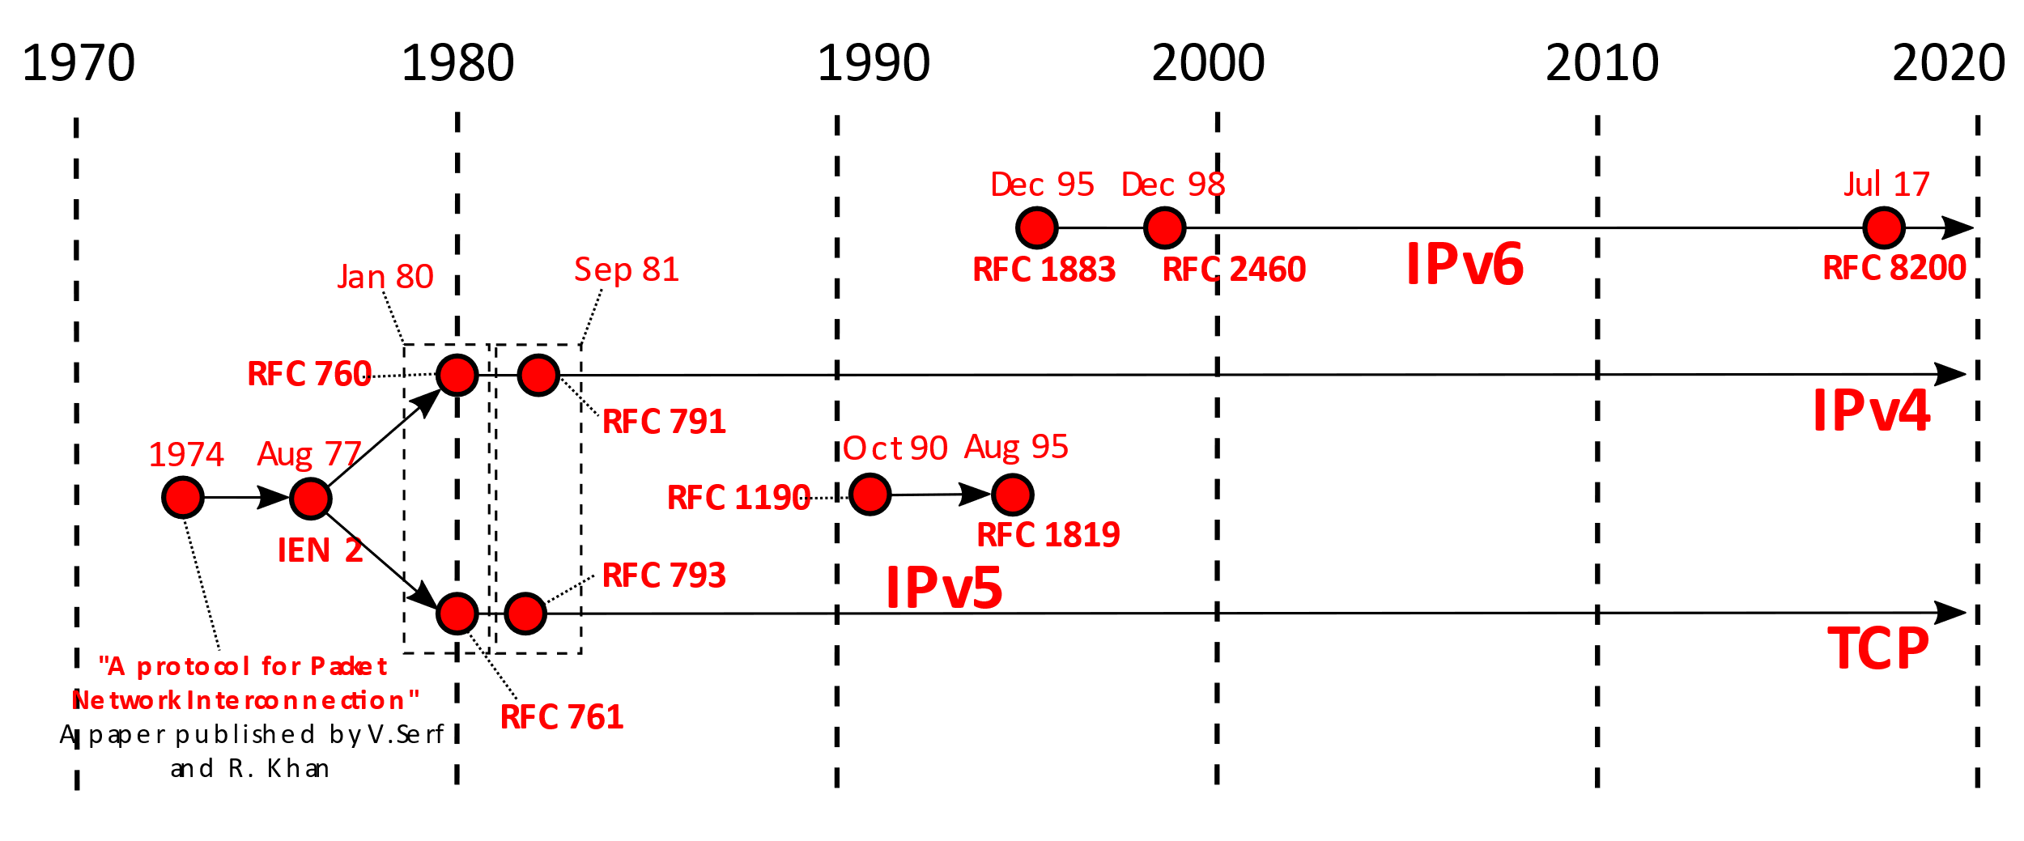
History of IP
By Michel Bakni - V. Cerf; R. Kahn (may 1974) https://tinyurl.com/wkcite?curid=79334079

Slide 3
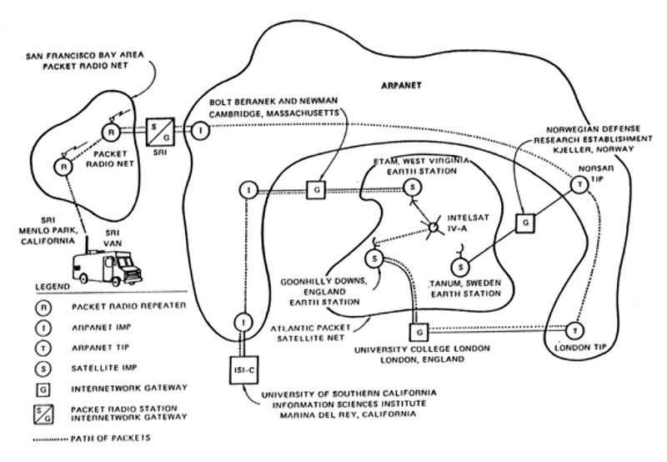
First “Internet”
By Author unknown - Computer History Museum, Public Domain, https://wkcite?curid=78988842

Slide 4
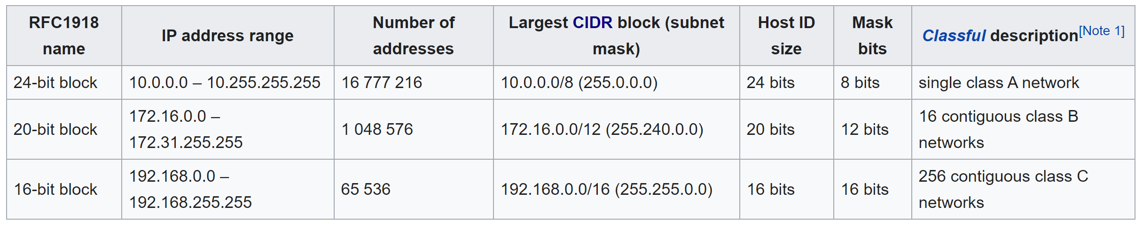
Reserved Addresses in IPv4
https://en.wikipedia.org/w/index.php?title=Private_network&oldid=991783834 (last visited Dec. 5, 2020).

Slide 5
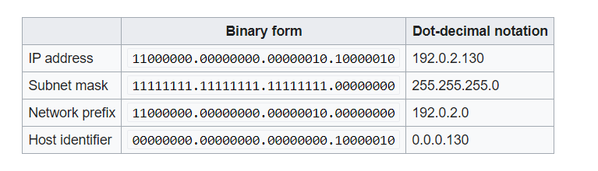
Network Prefix and Host identifier
https://en.wikipedia.org/wiki/Subnetwork (last visited Dec. 8, 2020).

Slide 6
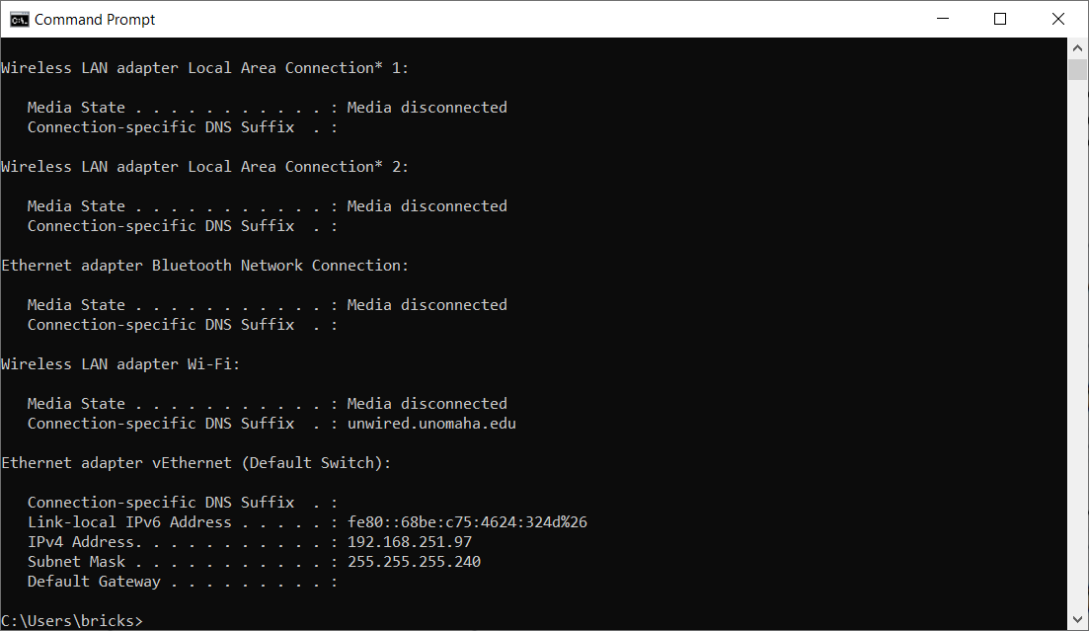
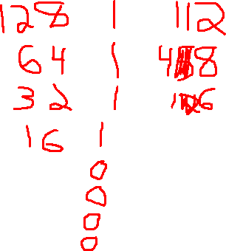

Slide 7
Subnet Masking
Does this packet stay in the network or leave the network?
i.e. Send this packet to the gateway or direct?
3 parts:
Subnet mask
Sender’s IP address
Receiver’s IP address

Slide 8
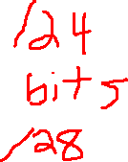
Subnet example
What | Value
Subnet Mask | 255.255.255.128
IP 1 | 192.168.0.129
IP 2 | 192.168.0.125

Slide 9
Subnet example (cont)
What | Value
Subnet Mask | 255.255.255.128
IP 1 | 192.168.0.129
IP 2 | 192.168.0.125
What | Value | Binary.
Subnet Mask | 255.255.255.128 | 00000000.000000000.000000000.000000000
IP 1 | 192.168.0.129 | 00000000.000000000.000000000.000000000
IP 2 | 192.168.0.125 | 00000000.000000000.000000000.000000000

Slide 10
CIDR Notation
Classless Inter-Domain Routing
Break from A, B, and C classes.
x.x.x.x/y

Slide 11
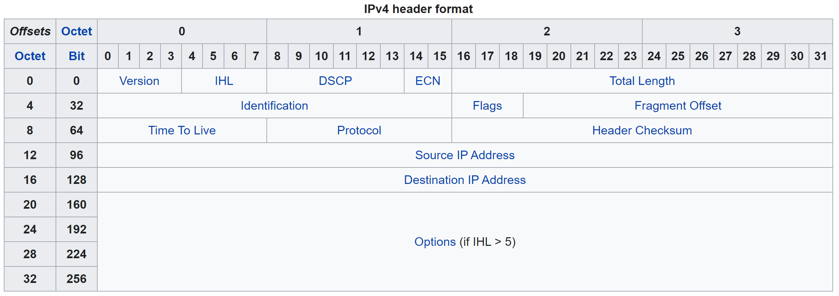
IPv4 Header
https://en.wikipedia.org/w/index.php?title=IPv4&oldid=990980009 (last visited Dec. 5, 2020).

Slide 12
IPv4 Header Parts
Version: Always 4 (for v4)
IHL (Internet Header Length): Length of header, including optionts
DSCP (Differentiated Services Code Point): Specify streaming, etc.
ECN (Explicit Congestion Notification):
Total Length
Identification: Fragmentation
Flags: 0 – must be zero, 1-Don’t fragment, 2-More fragments
Fragment Offset
TTL (Time to Live)

